Slide 1
Membrane Transport Proteins in Metal Defense
László Szalai
Markus J. TamÁs Supervisor
University of Gothenburg October 2024

Slide 2
Metallostasis
Importance of homeostasis in cells
Different homeostatic systems are present
Metal homeostasis is one of them

Slide 3
Different metals
Essential metals (e.g. Zink, Copper, Iron)
Complexes, structures and cofactors
Non-essential metals (e.g. Arsenic, Cadmium, Lead)
Excess metals cause toxicity

Slide 4
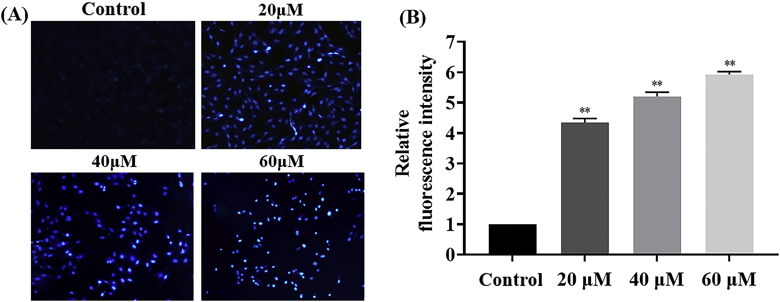
Metal toxicity
Oxidative stress
Damage to cellular structures
Cancer
Apoptosis

Slide 5
Metal Control
Transportation and sequestration are most prominent methods
Through the cell membrane, tonoplast and nuclear envelope
Multiple complexes take part in them
Membrane transport proteins

Slide 6
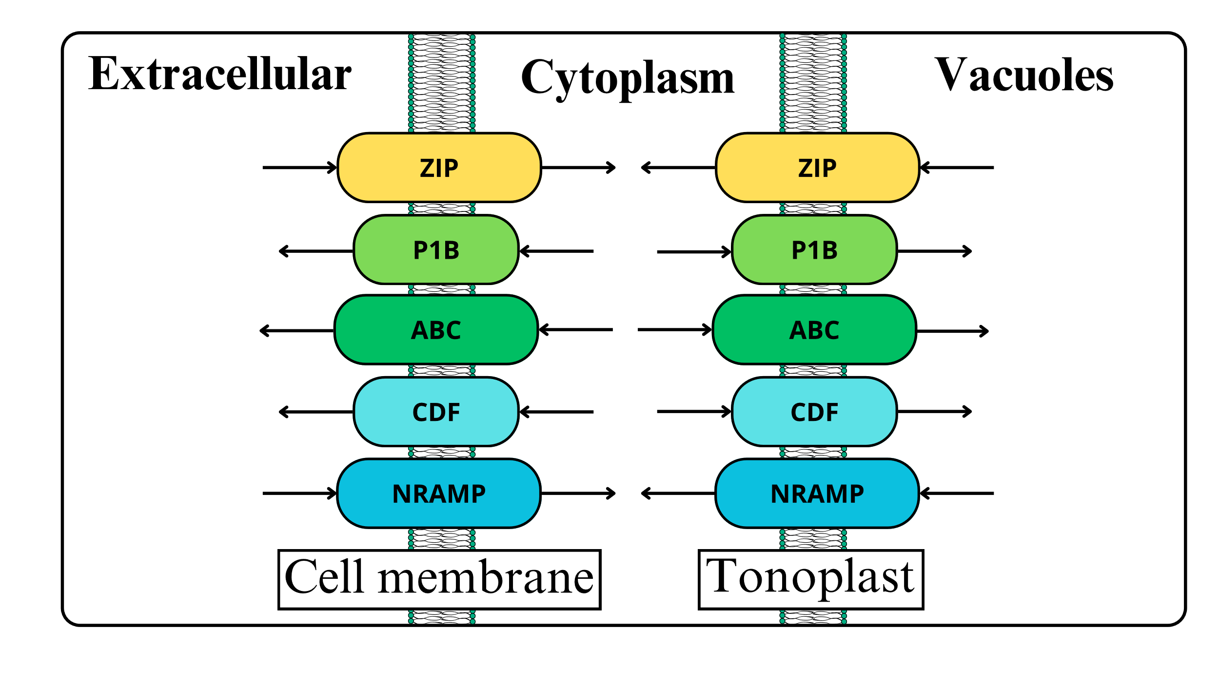
Membrane transport protein (MTP)
Protein complexes in membranes with transmembrane transport capability

Slide 7
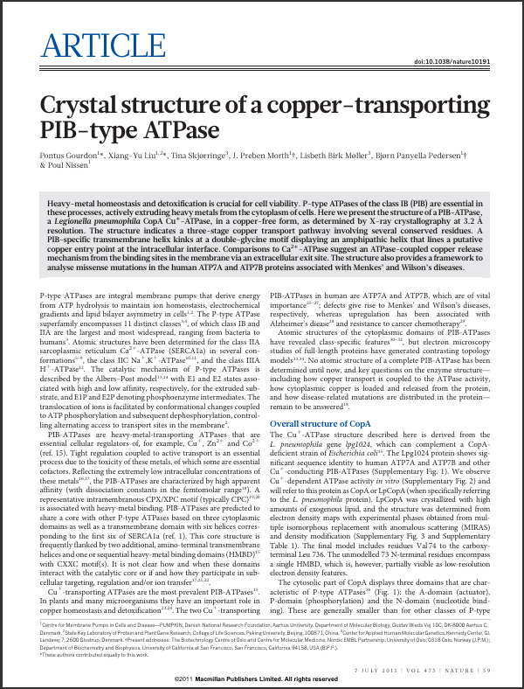
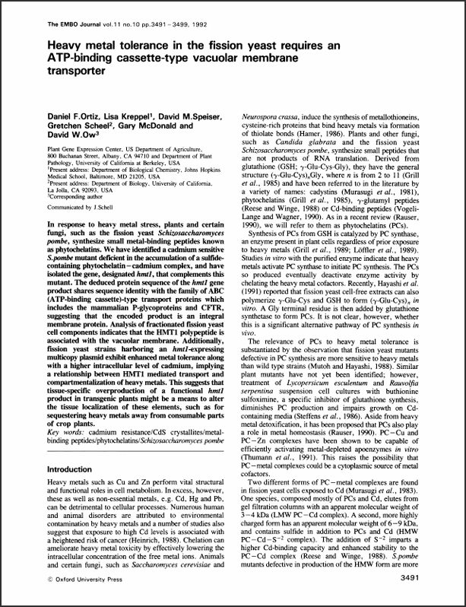
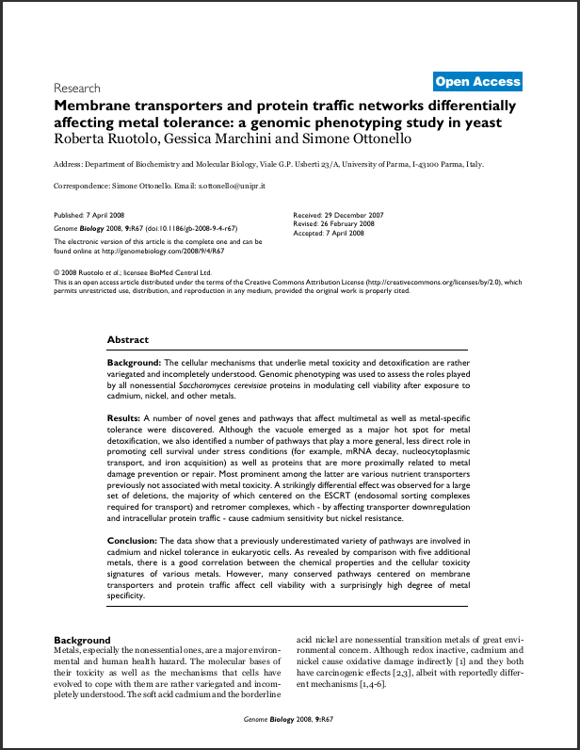
The three research
Shows mechanisms and importance
How the earlier MTPs were found
What their structure is
Genomic phenotyping

Slide 8
Article 1 – HMT1 - identification
Mutagenized fission yeast progenitor strain
Found a number of Cd sensitive strains
All had elevated phytochelatin complex
Plasmid vector gene restoration
Only HMT1 coding gene restored metal tolerance

Slide 9
Article 1 – HMT1 - effect
Further study shows increased uptake capacity not lower concentration
Therefore, concluded to be tonoplast MTP
Sequesters Cd into vacuoles
Overexpression leads to higher tolerance

Slide 10
Article 1 – HMT1 - perspective
Databank analysis shows ties to ABC MTPs
Can be found in multiple species
Could help develop agriculture aid in metal defense by sequestering to otherwise inedible parts of plants

Slide 11
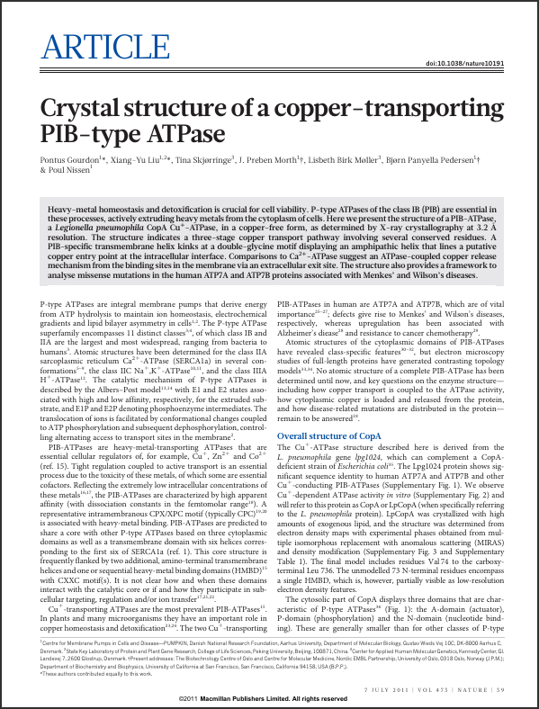
Article 2 – CopA – origin
First P1B-type ATPase to have a complete atomic structure mapped
Primary heavy metal efflux transporters
Legionella pneumophilia strain
High similarity to human P1Bs that cause Menke’s and Wilson’s disease when absent

Slide 12
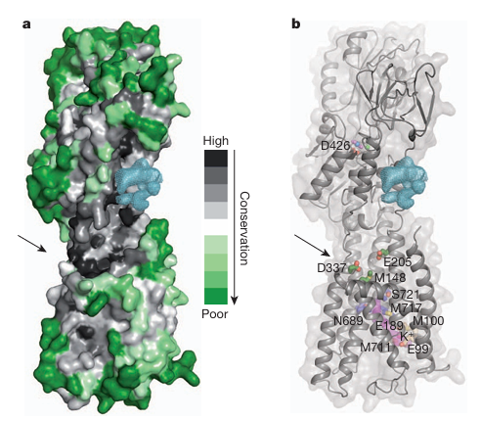
Article 2 – CopA – method
CopA was crystallized with exogenous liquids
Mapped with MIRAS electron density mapping
Multiple domains and major mechanism theories have been observed

Slide 13
Article 2 – CopA – domains and mechanism

Slide 14
Article 2 – CopA – perspective
ATP driven conformational changes cause the translocation of metals outside of cell
Hence the powerful metal efflux
Homology with human P1Bs makes CopA a good starting point in further researches tied to Menke’s and Wilson’s disease

Slide 15
Article 3 – genomic phenotyping - method
Researchers used a library of 4,700 deletion mutant strains of S. Cerevisiae
Exposed them to sublethal amount of Cadmium and Nickel in a high throughput screening process
Notes:
Deletion mutants are one non-essential gene mutations. They used high throughput screening with growth assays.

Slide 16
Article 3 – genomic phenotyping – sensitive strains
Dozens of sensitive and resistant strains were found
Notes:
Deletion mutants are one non-essential gene mutations. They used high throughput screening with growth assays.

Slide 17
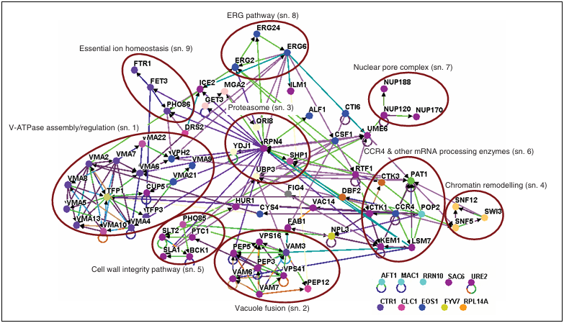
Article 3 – genomic phenotyping – gene ontology
Categorized every gene by their function and what biological processes they are tied to
Notes:
Deletion mutants are one non-essential gene mutations. They used high throughput screening with growth assays.

Slide 18
Article 3 – genomic phenotyping – perspective
The study revealed many novel genes coding MTPs and pathways tied to metal defense
Vacuoles’ part in the defense
Emphasizing the specificity, complexity and importance of MTP
Notes:
Deletion mutants are one non-essential gene mutations. They used high throughput screening with growth assays.

Slide 19
Summary
MTPs are central players in the defense against metal toxicity
The three studies showed the importance of MTPs
And that no one complex is responsible for metal defense but rather the delicate system including and building around the MTPs
Notes:
Deletion mutants are one non-essential gene mutations. They used high throughput screening with growth assays.

Slide 20
Final thoughts
“Homeostasis does not occur by chance, but is the result of organized self-government.” – Walter B. Cannon
...and metal homeostasis abides by this principle

Slide 21
References
X. Cao et al., “Cadmium induced BEAS-2B cells apoptosis and mitochondria damage via MAPK signaling pathway,” Chemosphere, vol. 263, p. 128346, Jan. 2021, doi: 10.1016/j.chemosphere.2020.128346.
D. F. Ortiz, L. Kreppel, D. M. Speiser, G. Scheel, G. McDonald, and D. W. Ow, “Heavy metal tolerance in the fission yeast requires an ATP-binding cassette-type vacuolar membrane transporter.,” EMBO J., vol. 11, no. 10, pp. 3491–3499, Oct. 1992, doi: 10.1002/j.1460-2075.1992.tb05431.x.
[15] P. Gourdon et al., “Crystal structure of a copper-transporting PIB-type ATPase,” Nature, vol. 475, no. 7354, pp. 59–64, Jul. 2011, doi: 10.1038/nature10191.
[16] R. Ruotolo, G. Marchini, and S. Ottonello, “Membrane transporters and protein traffic networks differentially affecting metal tolerance: a genomic phenotyping study in yeast.,” Genome Biol., vol. 9, no. 4, p. R67, Apr. 2008, doi: 10.1186/gb-2008-9-4-r67.

