Slide 1
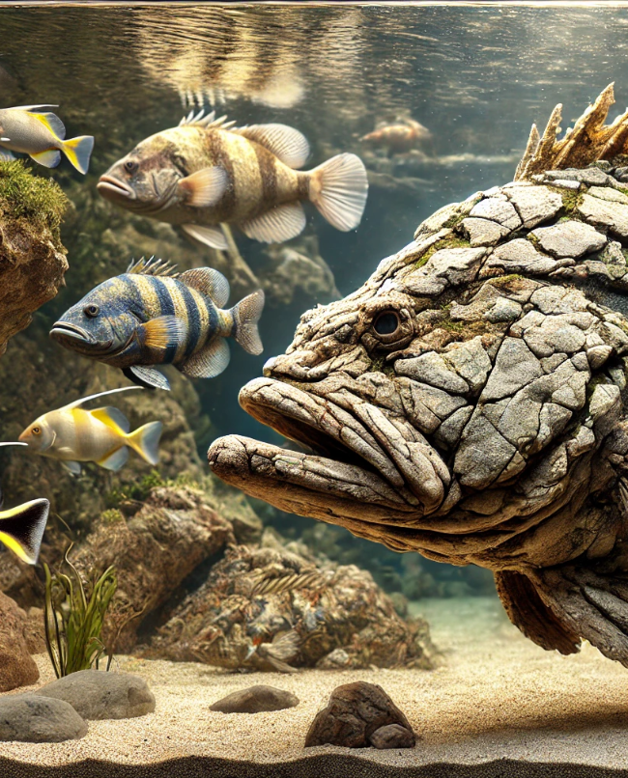
Origin and evolution of extreme life span in Pacific Ocean Rockfishes
Kolora et al. 2021 Science
László Szalai
University of Gothenburg December 2024
Real photo I promise

Slide 2
Longevity
Vertebrates live for about 5 weeks to 400 years
Diverse, 3 orders of magnitude difference
Aging accompanied by
  Genome instability
  Loss of function and proteostasis…

Slide 3
Rockfish (genus Sebastes) of the Pacific Ocean
Experience a lifespan of 11-200 years
About 120 species
Varying maximum age within close groups
Repeated adaptation affecting longevity

Slide 4
Data collection
Sequence and de novo assembly of genome
88 species (representing most of Sebastes)
99.99% accuracy and 91-97% genome readiness
Identified on average 25.000 protein coding genes

Slide 5
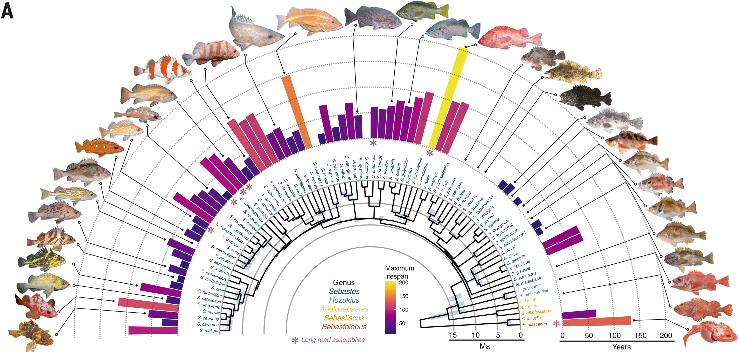
Age and phylogeny
Notes:
Convergent genes or advance of ancestral genes

Slide 6
Specific order of analysis
DNA repair and maintenance genes
General positive selection pressure genes
Gene copy number multiplication
Genetic diversity

Slide 7
DNA repair and maintenance genes
Positive selection pressure – 800 genes found
Narrowed for DNA ds break repair – 16 genes
Telomere- and base excision repair associated
Can be found across vertebrates
Notes:
They selected long lived species and narrowed for DNA repair and maintenance = 16

Slide 8
General positive selection pressure
Positive selection pressure – 800 genes found
Narrowed for q<0.05 and found 91 genes
Most prominent factors like depth and size
Linear model based on these factors

Slide 9

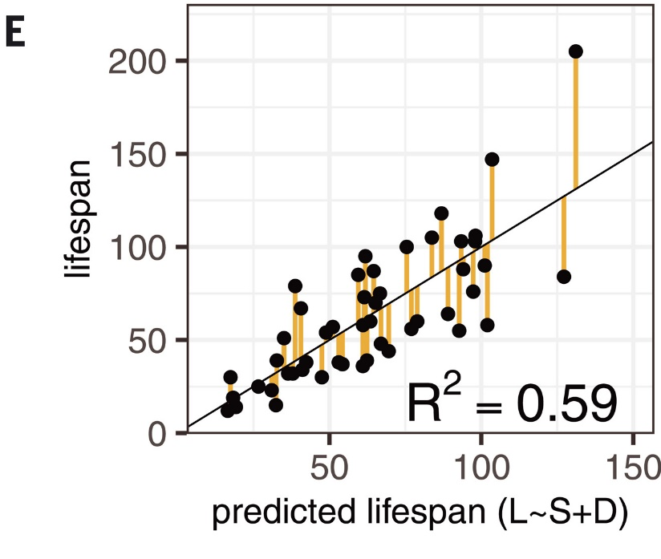
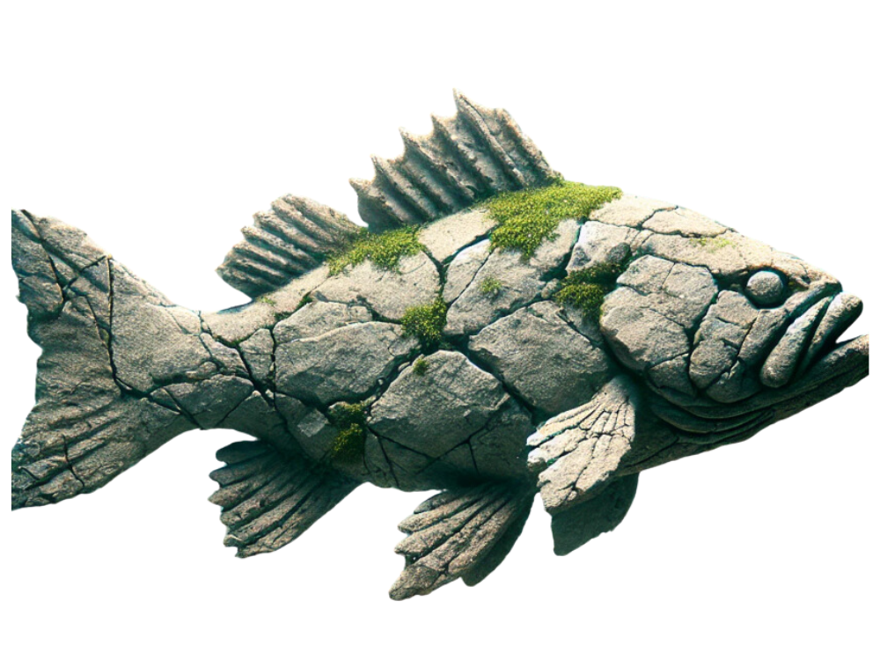
General positive selection pressure - model
Life expectancy
Linear model
Size at maturity
Maximum depth

Slide 10
General positive selection pressure - results
Out of more than 800 genes only 56 remained
10 of them were statistically significant too
Not connected to size and depth
Most of them in insulin and glucose signaling
Some in apoptosis, proliferation, cell growth…

Slide 11
Gene copy number multiplication
Multiple genes showed multiplication with PSP
Most prominent cluster group on chromosome I
2/3 of them were Butyrophilin associated genes
B7 immunoglobulin family, inflammation related

Slide 12
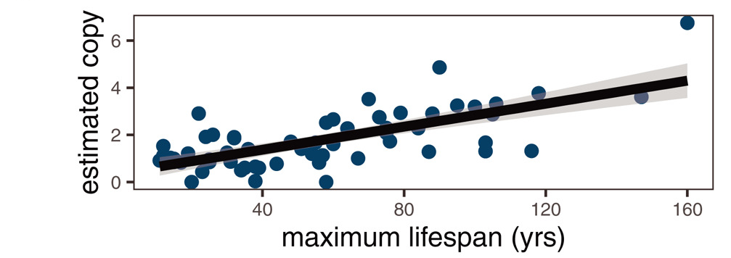
Gene copy number multiplication - correlation
In most long-lived species 22 segmental duplications can be found (>1kb)
The mentioned cluster can have even 7 copies

Slide 13
Genetic diversity
Long-lived species have higher heterozygosity
Positively correlates with lifespan
May lower genetic diversity due to small pop. size
Means conserved traits but also vulnerability

Slide 14
Lifespan effects
Longer life span introduces new correlations
  + Maturity age
  + Survival rate
  Population size
  Fecundity

Slide 15
Summary
Evolutionary steps in rockfishes allowed researchers to dissect the genetic adaptations
Dozens of genes found to be associated to lifespan directly and indirectly
Some of them in insulin and glucose signaling and inflammation pathways
Further proved utility of genus-wide studies

Slide 16
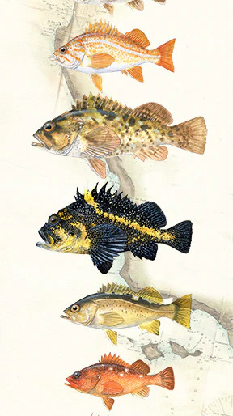
Final thoughts
Rockfish longevity highlights how evolutionary pressures shape genetic adaptations.
With every discovery, we deepen our understanding of the mechanisms that govern lifespan.

